Slide 1
LOAD ASPECT RECOGNITION BASED DATA COMPRESSON IN SMART METERS
K.ANUPALLAVI(211413205011)
PROJECTGUIDE :Mrs.S.UMA
D.SELVA MARY(211413205093) DESIGNATION : Assistant Professor
M.BINCY IMMACULATE(211413205021)
U.LOGESWARI(211413205051)

Slide 2
ABSTRACT
Power line carrier communication has as of late pulled in the consideration of vitality organizations as a helpful and common innovation for building the advanced prepaid metering infrastructure and to balance the electricity without fluctuation.
The voltage fluctuation is also reduced .
The customer and the system can be interacted without the help of EB officers.
This system particularly focus on the activities of power line communication technology and provide the electricity to the customer without any fluctuation till the maximum level of electricity consumption is reached.
A person need not go to EB station for billing and payment.

Slide 3
LITERATURE SURVEY
S.NO | NAME OF THE PAPER WITH YEAR | OBJECTIVE | PROS | CONS
1 | The wireless automatic meter reading and control system based on STC12C5A60S2. (2008) | The remote meter reading and control for long distance transmission without any restriction . | High transmission rate. High accuracy. | Simultaneous transmission of power and data is not possible.
2 | Design of wireless ARM-based automatic meter reading and control system . (1999) | This implements a wireless ARM-based automatic meter reading and control system for distribution automation via GPRS network. | Cost effective. Accurate. Reliable. It can provide extra capabilities such as distribution automation,load management . | Expensive. Simultaneous transmission of power and data is not possible.

Slide 4
S.NO | NAME OF THE PAPER WITH YEAR | OBJECTIVE | PROS | CONS
3 | Advanced metering infrastructure performance using European low -voltage power line communication networks . (2016) | It is suitable for smart grid application such as automatic meter reading. | Simultaneous transmission of power and data is possible. Low voltage consumption. | High cost.
4 | Automated discovery of dependencies between logical components in document image understanding. (2001) | It is based on recognition of visual models. In order to automatically acquire these models we propose the application of machine learning. | Mutual relationship between logical components . Sensible to learn rules and relationship. | Failure of recognition. Simultaneous transmission of power and data is not possible.

Slide 5
EXISTING SYSTEM
In existing system, the possibility to use the networks for the grid monitoring system has been explored.
It is validated through a dedicated experimental set-up.
Each smart meters is connected to the MDC by means of a performing broadband power line communication network

Slide 6
DISADVANTAGE OF EXISTING SYSTEM
Heavy billing.
Bill payment is manual.
Has low voltage supply( fluctuation ).

Slide 7
PROPOSED SYSTEM
In this proposed system we going to implement that A PLCC Based Reliable and Efficient Power Metering System for Energy Management.
Power metering system will monitor the consumed power in particular home and transmitted via PLCC.
The bill payment section will be take place in home itself. RFID reader will detect the smart card and amount selection via keypad.
Controller will check remaining amount continually, If balance is below certain level buzzer will be turn on.

Slide 8
When the person is aware about the consumed electricity then there may be a chance of sustainable usage and the recharge can be done whenever required.
It avoids low voltage (fluctuation) and balances the supply which is a basic need consumption.
So, that the distributed power supply can be used efficiently.

Slide 9
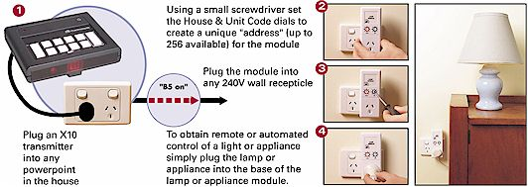
PLCC

Slide 10
ADVANTAGE OF PROPOSED SYSTEM
Prepaid meter prevents the person from heavy billing.
Easy to implement in smart cities.
It can be reduce the man power.
Avoids voltage fluctuation.

Slide 11
APPLICATIONS OF PROPOSED SYSTEM
Advanced Metering System
Safety EB Metering System

Slide 12
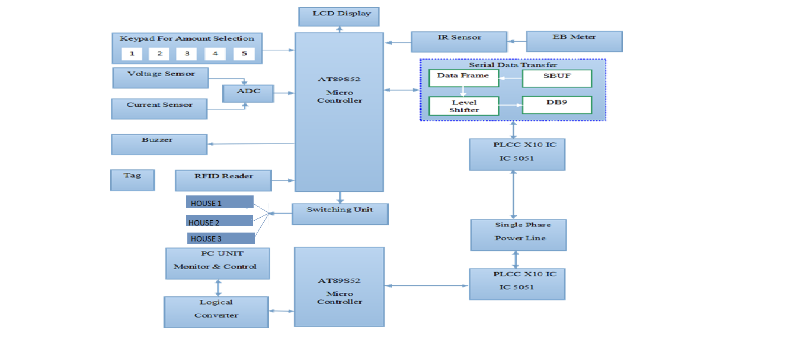
BLOCK DIAGRAM

Slide 13
HARDWARE REQUIREMENTS
MICRO CONTROLLER
1*5 KEYPAD
LCD
RELAY
AC LOAD
RFID READER & TAG
PLCC X10 IC 5051
IR SENSOR
VOLTAGE SENSOR
CURRENT SENSOR
BUZZER

Slide 14
SOFTWARE REQUIREMENTS
KEIL IDE
EMBEDDED C
VB 6.0

Slide 15
CODING
#include <REGX51.H>
#define MYDATA P0
sbit rs=P3^2;
sbit rw=P3^3;
sbit en=P3^4;
sfr datas=0xA0;
sbit A1=P1^0;
sbit A2=P1^1;
sbit A3=P1^2;
void lcdinit(void);
void lcdcmd(unsigned char );
void delay(unsigned int del);
void lcddata(unsigned char ldat);

Slide 16
Cont.
void lcdinit(void) {
lcdcmd(0x38);
lcdcmd(0x38);
lcdcmd(0x38);
lcdcmd(0x06);
lcdcmd(0x0e);
lcdcmd(0x01);
lcdcmd(0x0C);
lcdcmd(0x80);
}
void lcdcmd(unsigned char lcmd) {
datas=lcmd;
rs=0;
rw=0;
en=1;
delay(50);
en=0;
}

Slide 17
Cont.
void delay(unsigned int del)
{
while(del--);
}
void lcddata(unsigned char ldat)
{
datas=ldat;
rs=1;
rw=0;
en=1;
delay(50);
en=0;
}
void Delay()
{ int i;
for(i=0;i<12000;i++);
}

Slide 18
Cont.
void init()
{
SCON=0x50;
TMOD=0X20;
TH1=0XFd;
TR1=1;
}
void txs(unsigned char value)
{
int i;
TI=0;
SBUF=value;
while(TI==0);
for(i=0;i<6000;i++);
}

Slide 19
Cont.
unsigned char val1[6],val,sp,spt,sptt;
void putchar(unsigned char val[16],char len)
{
char i;
for(i=0;i<len;i++)
{
lcddata(val[i]);
}
}
char ii;
long ll;

Slide 20
Cont.
void main() {
int i=0,v=200,v1=0,d=0,er=0,cnt1=0,ff=0;
unsigned int hb=0,cnt=0,cur=0;
init();
lcdinit();
txs('A');txs('T');txs(13); txs(10);
lcdcmd(0x80);
putchar("Show Card ",16);
while(P3_6==1);
P1_7=1;
P1_6=1;
P1_5=1;
P1_4=1;
P1_3=1;
lcdcmd(0x80);
putchar("Enter Amount ",16);

Slide 21
Cont.
while(cnt1==0)
{
if(P1_7==0)
cnt1=300;
if(P1_6==0)
cnt1=200;
if(P1_5==0)
cnt1=100;
if(P1_4==0)
cnt1=50;
}
// cnt1=cnt1+100;
lcdcmd(0x80);
putchar(" ",16);

Slide 22
Cont.
while(1)
{
while(RI==0)
{
P1_0=0;
P1_1=0;
P1_2=0;
Delay();
val1[0]=MYDATA;
lcdcmd(0xC0);
lcddata('V');
lcddata('=');
lcddata((val1[0]/100)+0x30);
lcddata(((val1[0]%100)/10)+0x30);
lcddata((val1[0]%10)+0x30);

Slide 23
Cont.
P1_0=1;
P1_1=0;
P1_2=0;
Delay();
val1[1]=MYDATA;
lcdcmd(0x86);
lcddata('I');
lcddata('=');
lcddata((val1[1]/100)+0x30);
lcddata(((val1[1]%100)/10)+0x30);
lcddata((val1[1]%10)+0x30);
if(P3_5==0)
{
while(P3_5==0);
if(cnt1>0)
cnt1=cnt1-5;
}

Slide 24
Cont.
if(cnt1==0)
{
P1_3=0;
}
else
{
P1_3=1;
}
if(cnt1<=20)
{
if(P1_7==0)
cnt1=cnt1+300;
if(P1_6==0)
cnt1=cnt1+200;

Slide 25
Cont.
if(P1_5==0)
cnt1=cnt1+100;
if(P1_4==0)
cnt1=cnt1+50;
P3_7=0;
lcdcmd(0xC8);
lcddata('R');
lcddata('e');
lcddata('c');
lcddata('h');
lcddata('a');
lcddata('r');
lcddata('g');
lcddata('e');
lcddata(' ');
lcddata(' ');
}

Slide 26
Cont.
else
{
P3_7=1;
}
/* if(val1[1]>35)
{
if(ll==0)
{
if(cnt1>10)
cnt1=cnt1-10;
else
cnt1=0;
ll=100;
}
}

Slide 27
Cont.
else if(val1[1]>15)
{
if(ll==0)
{
if(cnt1>50)
cnt1=cnt1-5;
else
cnt1=0;
ll=100;
}
}
if(ll>0)
ll--;

Slide 28
Cont.
if(cnt1<=10) {
if(P3_5==0) {
if(P1_7==0) {
cnt1=cnt1+50;
P3_7=1;
P1_2=1;
}
if(P1_6==0) {
cnt1=cnt1+100;
P3_7=1;
P1_2=1;
}
if(P1_5==0) {
cnt1=cnt1+150;
P3_7=1;
P1_2=1;
}
}

Slide 29
Cont.
lcdcmd(0xCD);
lcddata('P');
lcddata('a');
lcddata('y');
}
else
{
lcdcmd(0xCD);
lcddata(' ');
lcddata(' ');
lcddata(' ');
lcddata(' ');
}

Slide 30
Cont.
if(cnt1<=0)
{
cnt1=0;
P3_7=0;
P3_6=0;
}
*/
lcdcmd(0x80);
lcddata('M');
lcddata('=');
lcddata(((cnt1%1000)/100)+0x30);
lcddata(((cnt1%100)/10)+0x30);
lcddata((cnt1%10)+0x30);
cnt++;

Slide 31
Cont.
if(cnt>=30)
{
cnt=0;
txs('A');
txs(((cnt1%1000)/100)+0x30);
txs(((cnt1%100)/10)+0x30);
txs((cnt1%10)+0x30);
txs('B');
txs((val1[0]/100)+0x30);
txs(((val1[0]%100)/10)+0x30);
txs((val1[0]%10)+0x30);
txs('C');
txs((val1[1]/100)+0x30);
txs(((val1[1]%100)/10)+0x30);
txs((val1[1]%10)+0x30);
txs('D');
} }

Slide 32
Cont.
val1[ii]=SBUF;
RI=0;
ii++;
if(ii==2)
{
ii=0;
lcdcmd(0x8E);
lcddata(val1[0]);
lcddata(val1[1]);
if(val1[0]=='T')
{
P1_3=1;
}

Slide 33
Cont.
if(val1[0]=='U')
{
P1_3=0;
}
if(val1[1]=='T')
{
P1_3=1;
}
if(val1[1]=='U')
{
P1_3=0;
}
}
}
}

Slide 34
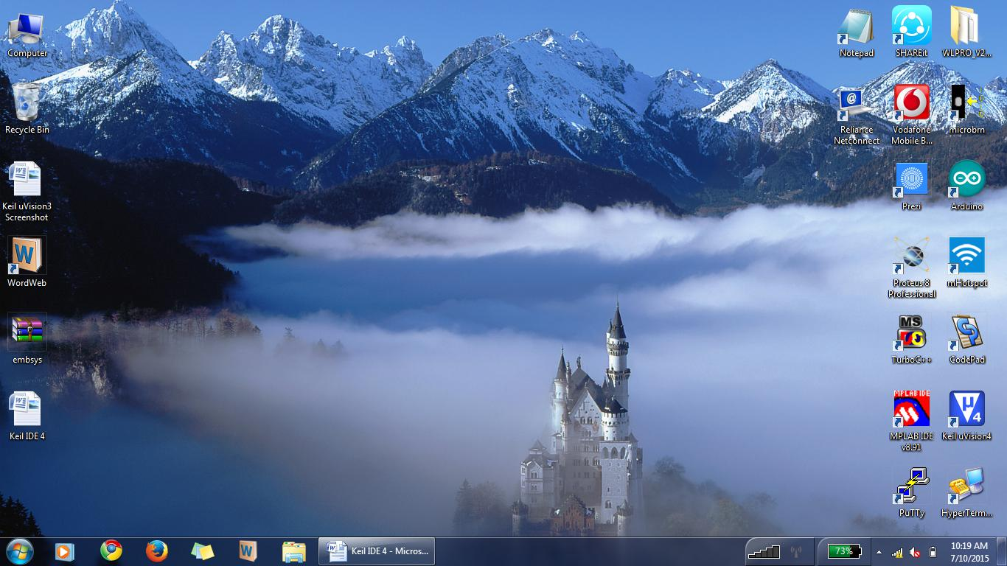
SNAP SHOTS
Keil 4 IDE Compiler Working Procedure
Double Click the Icon

Slide 35
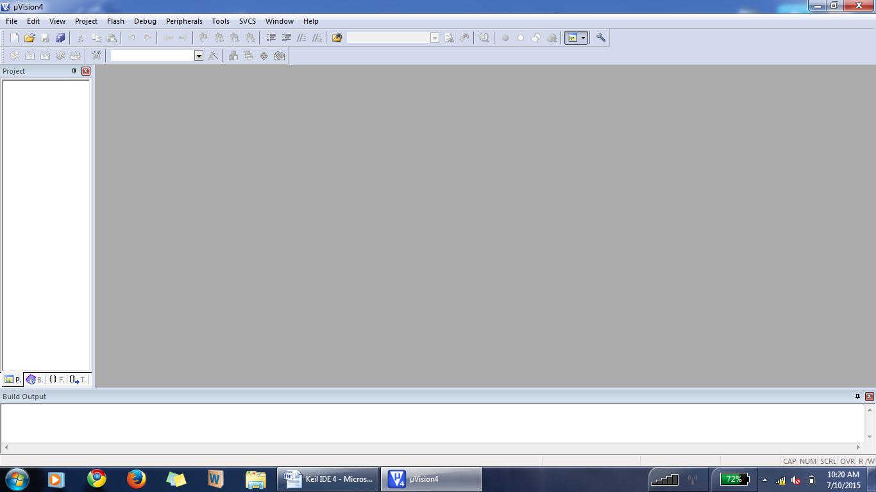
Click “Project”

Slide 36
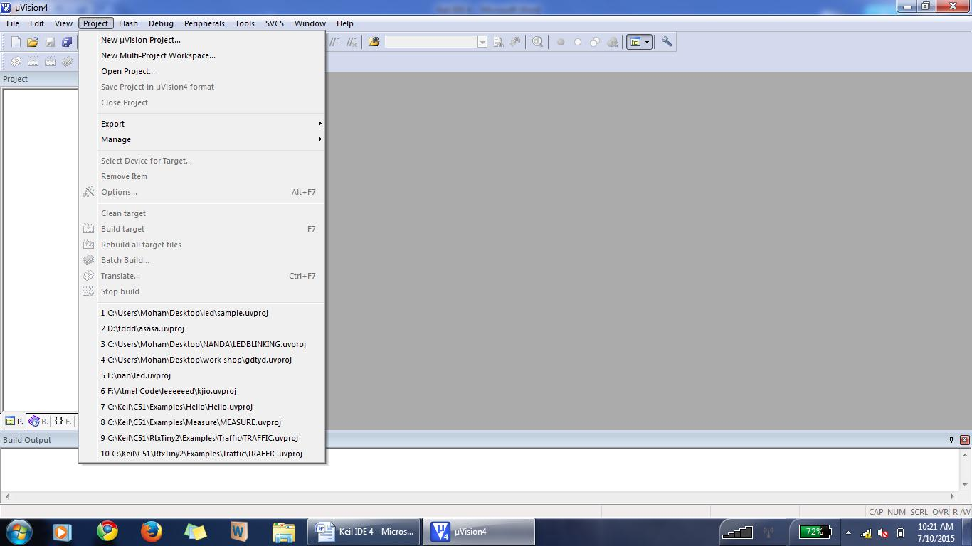
Then Click “New Uvision Project”

Slide 37
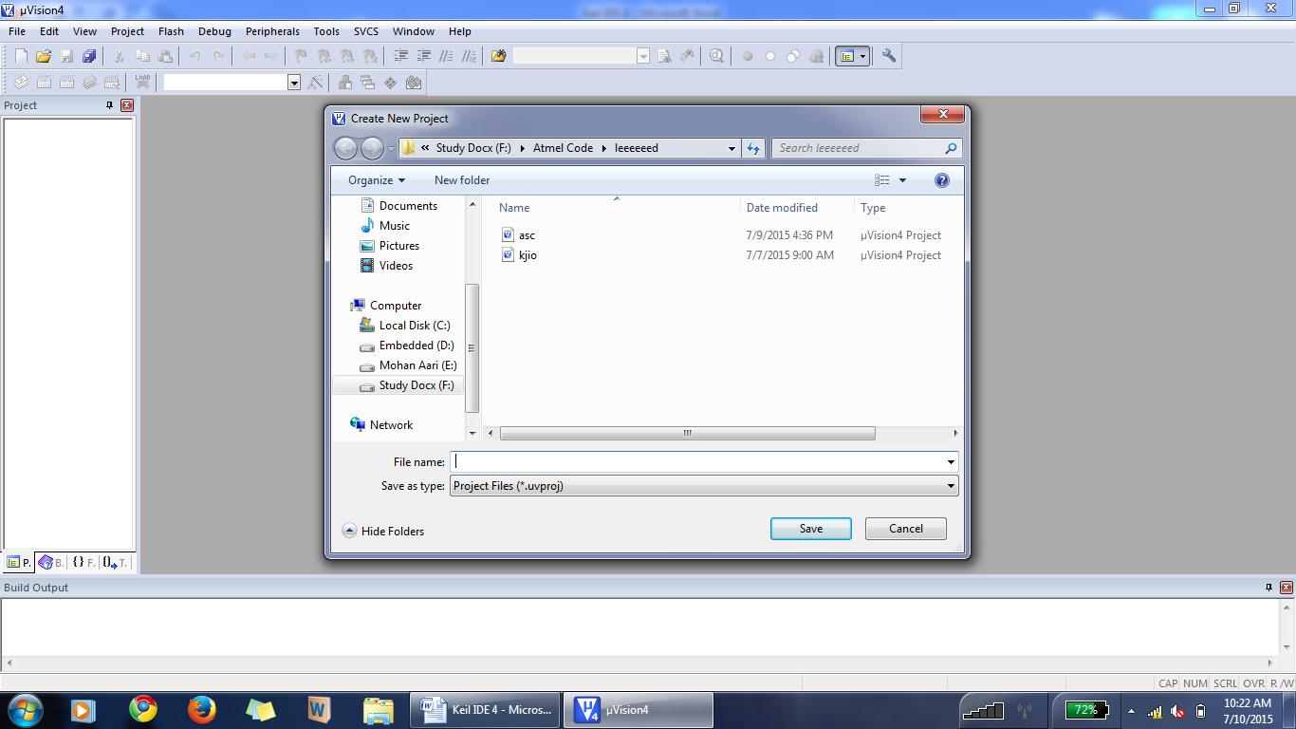
Select The Storage Path

Slide 38
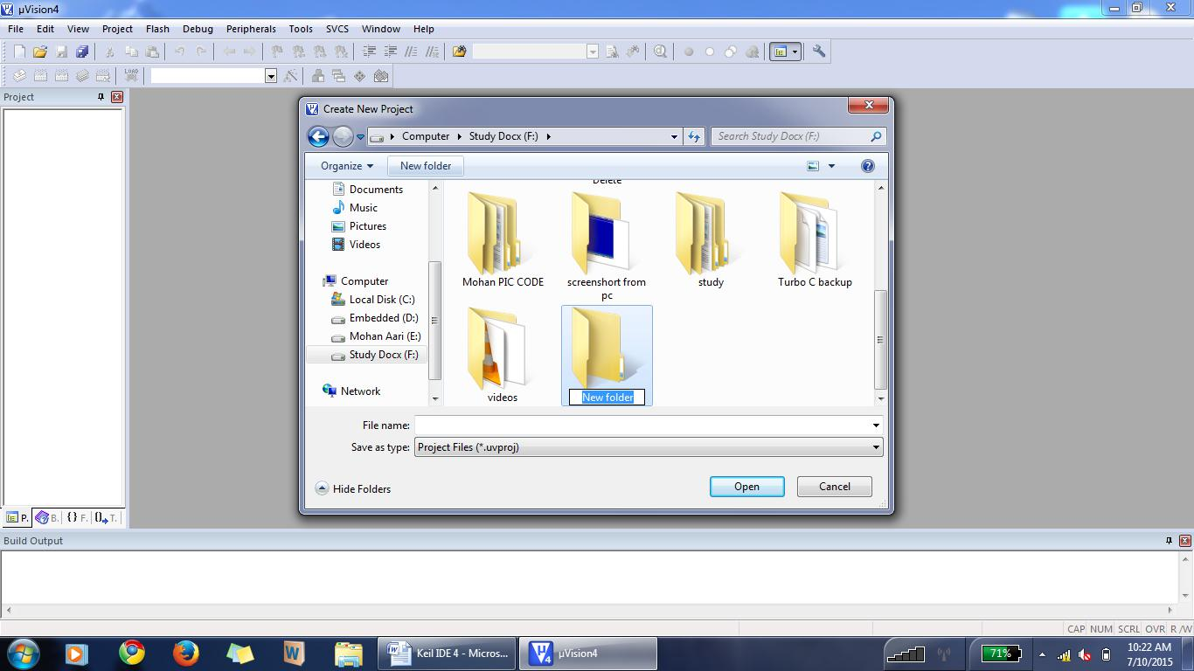
After Path Selection. Create “New Folder”

Slide 39
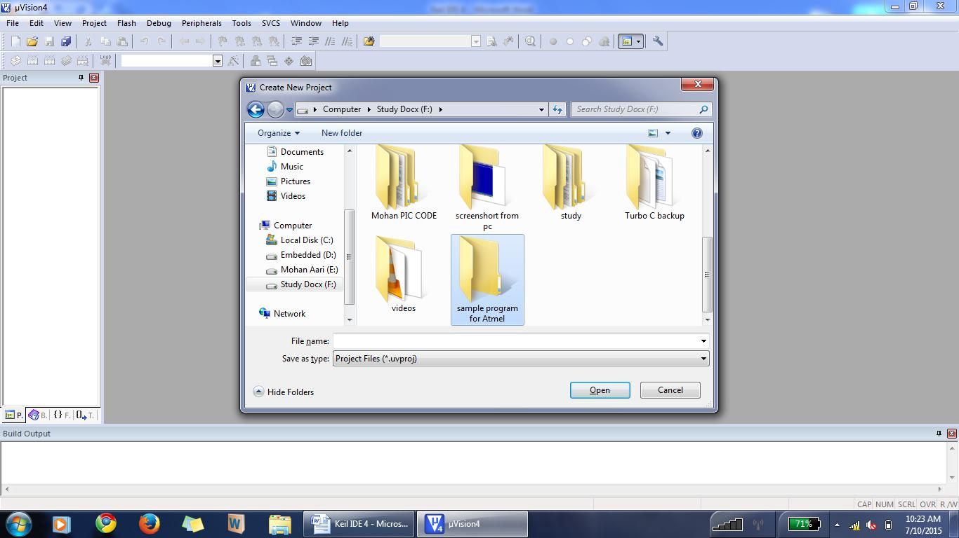
Give The Folder Name & Double Click

Slide 40
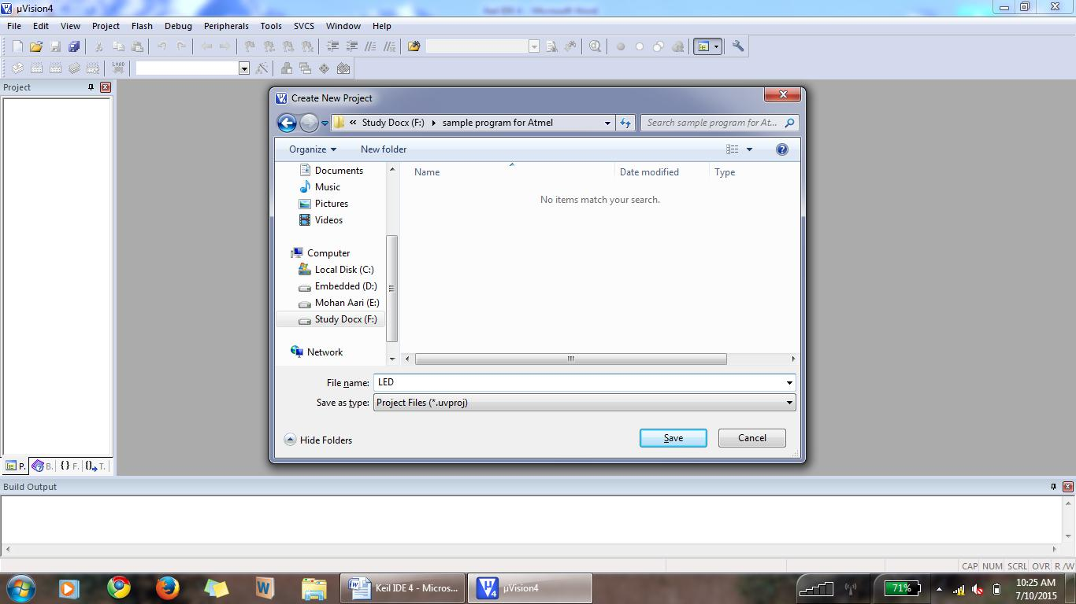
Enter The File Name & Click “save”.

Slide 41
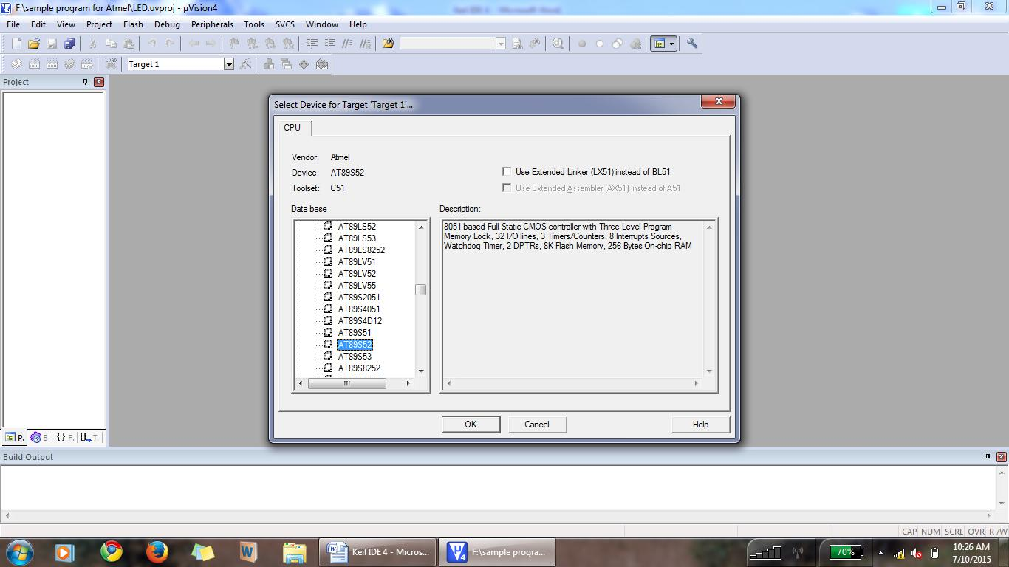
Double Click -->”Atmel”.

Slide 42
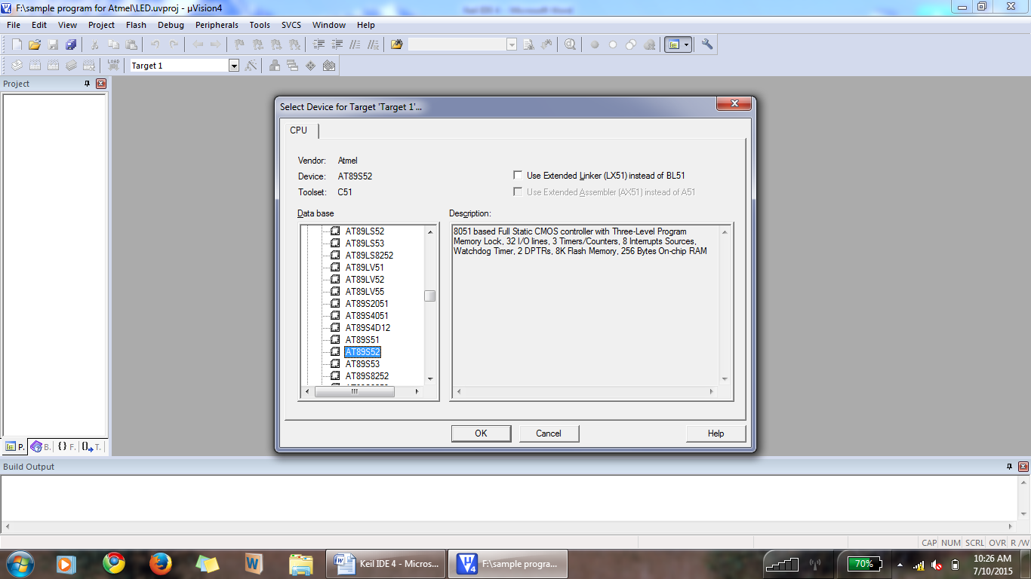
Then Select “AT89S52” & Click “OK”.

Slide 43
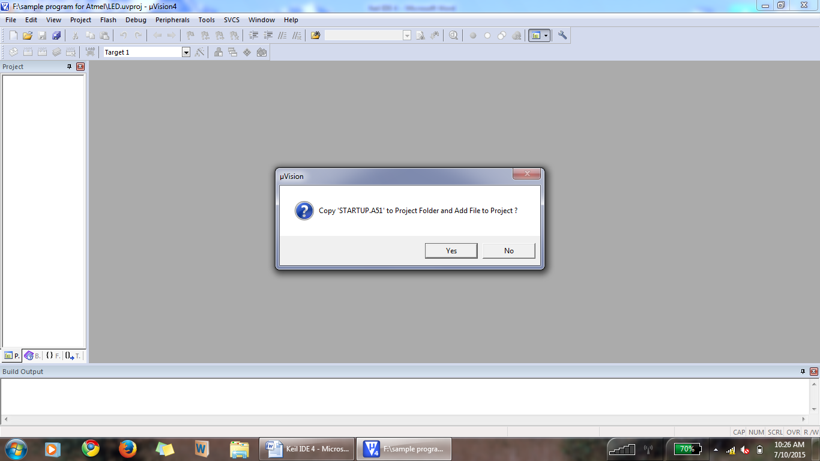
Click -->“YES”

Slide 44
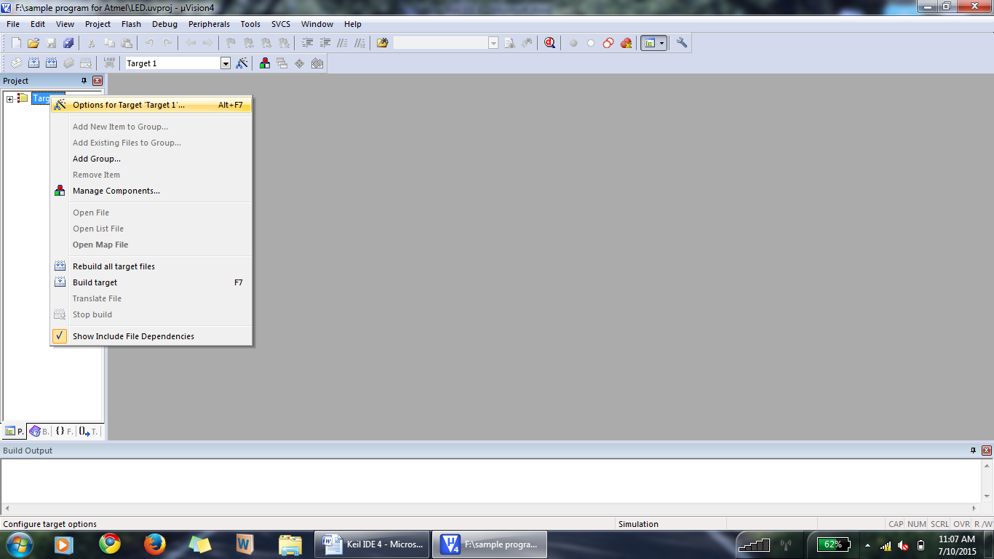
Right Click The ‘Target1’ & Select “Options For Target ‘Target1’”.

Slide 45
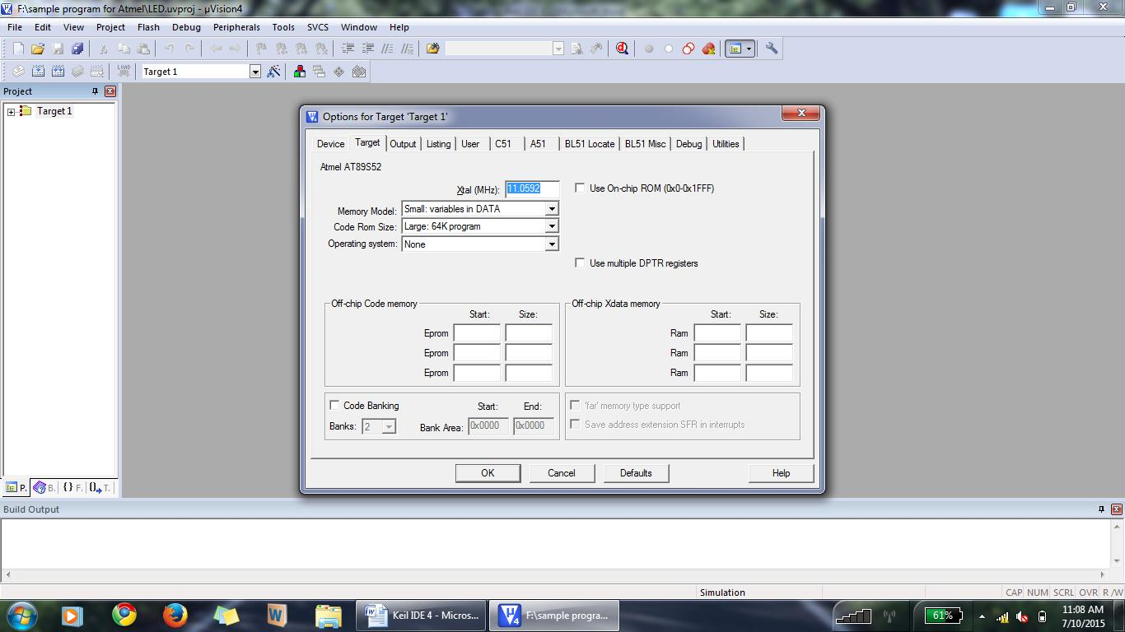
Set The Frequency As 11.0592.

Slide 46
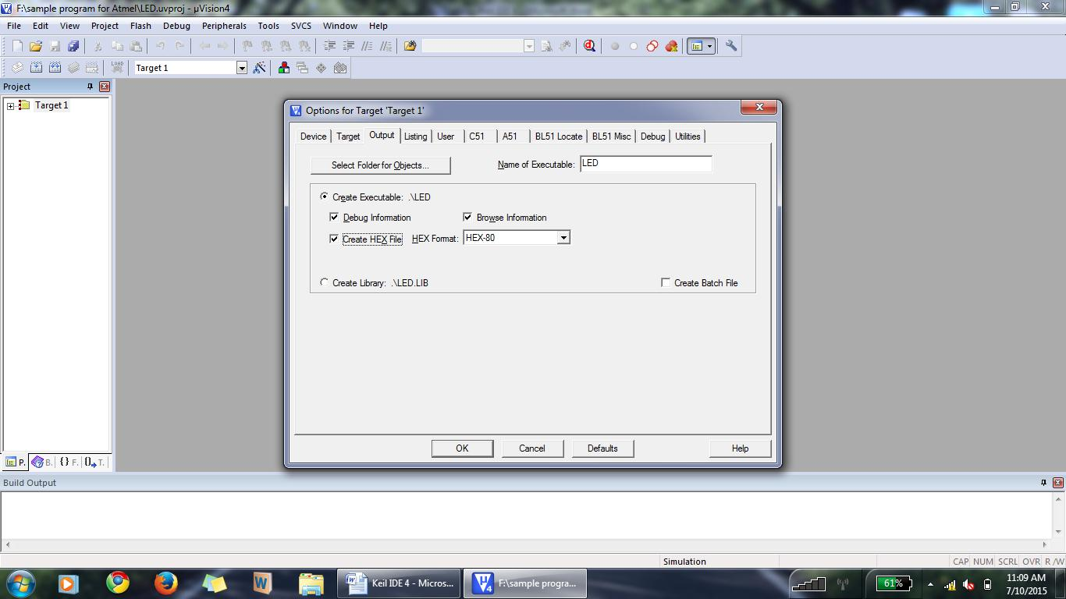
Click-->”Output” & Select “Create HEX File”.

Slide 47
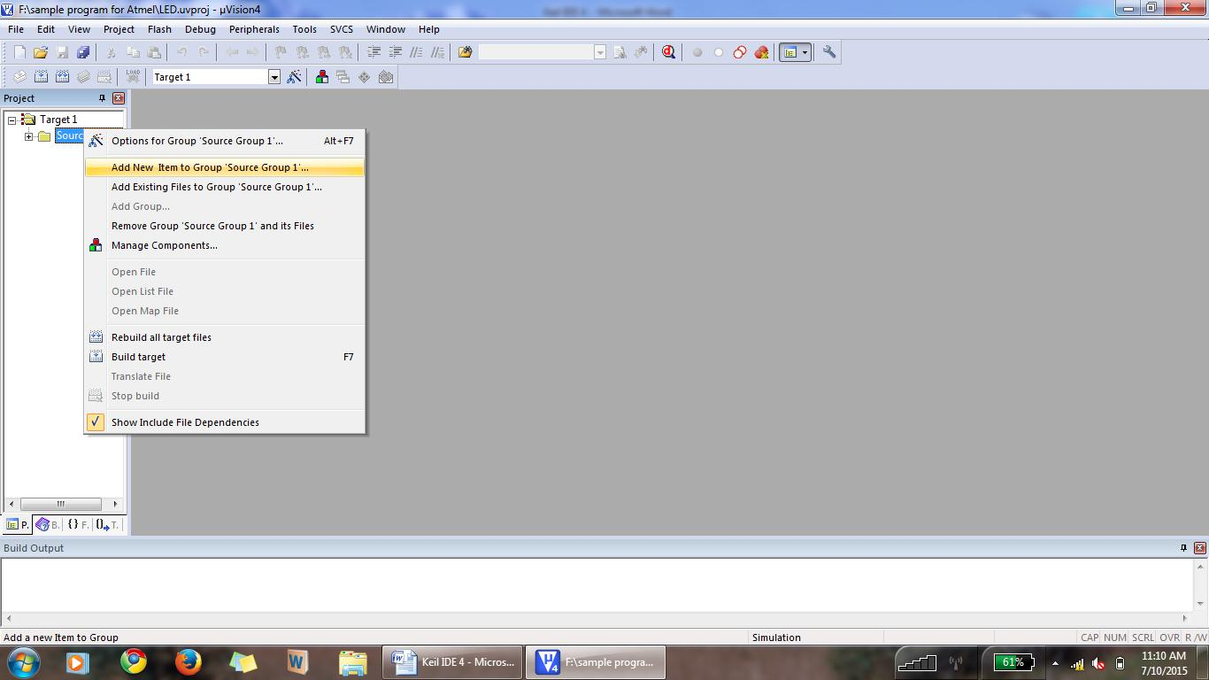
Right Click The “Source Group 1” & Select “Add New Item To Group ‘Source Group 1’”.
If “source Group 1” is not available Just Click the + symbol Which is before the ‘Target1’.

Slide 48
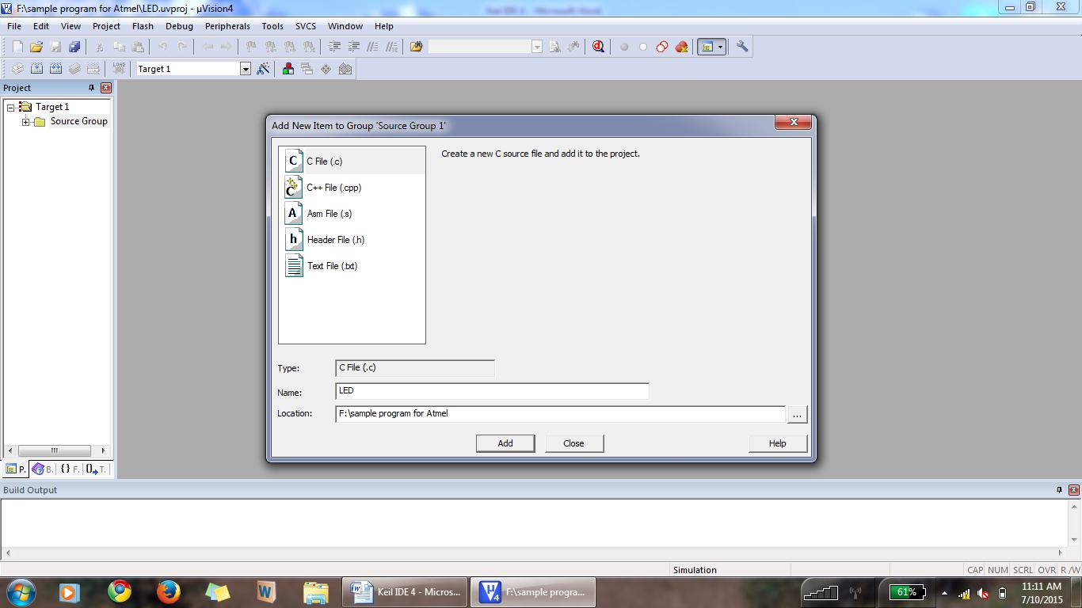
Select The File Type As “C File(.c)” & Give The File Name Then Click “ADD”.

Slide 49
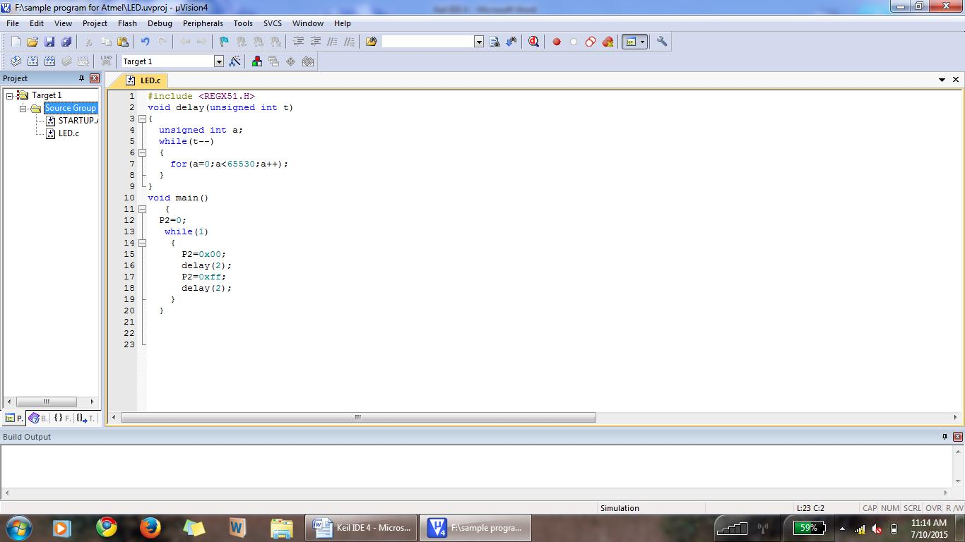
Type The Program Here & Save The File By File-->Save/Ctrl+S.

Slide 51
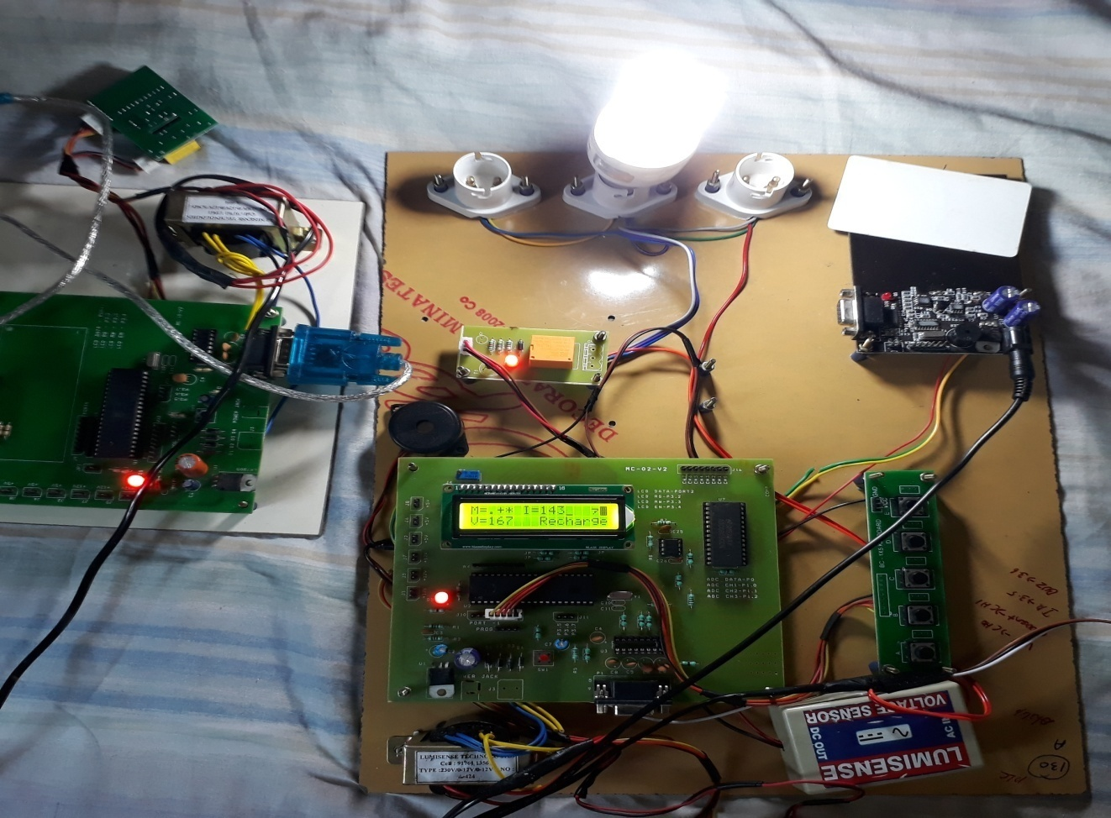
OUTPUT:

Slide 52
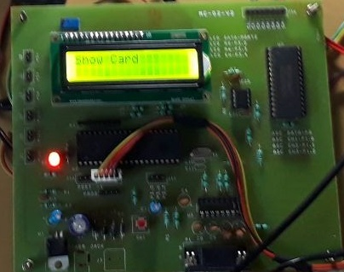
1.show card for recharge

Slide 53
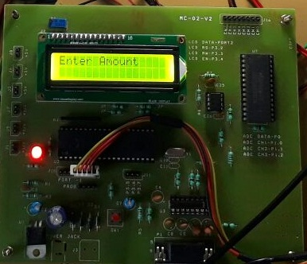
2.Enter amount using keypad

Slide 54
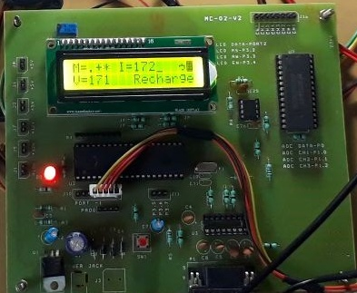
3. when reached minimum amount shows recharge

Slide 55
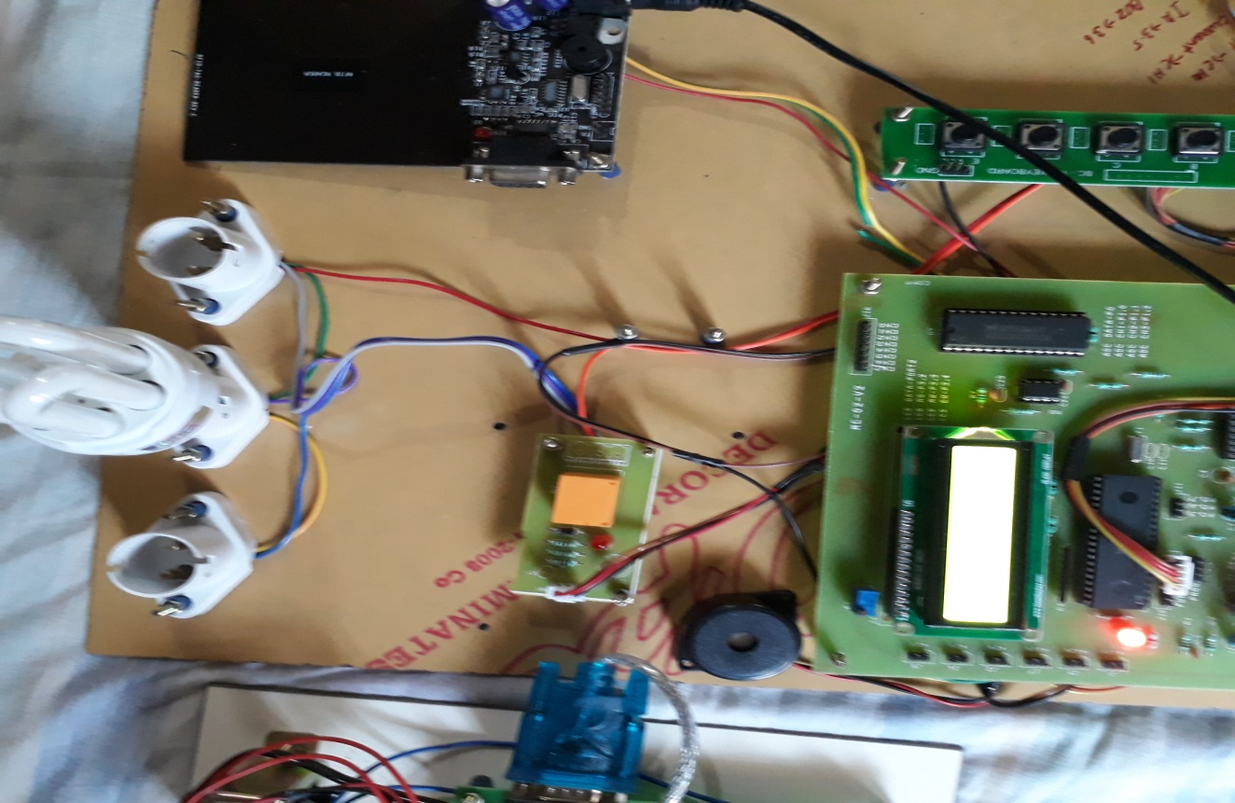
4. when the system is not recharged the power cuts automatically.

Slide 56
REFERENCES
[1] J. Magalhaes Alves, et al. "Keen Matrices: Resource administration in essential conveyance substations, with savvy sensor systems", in Proc. of IEEE CIRED 2013, pp.1-4, 10-13 June 213.
[2] G. Accetta, D. Della Giustina, G. D'Antona, R. Faranda and S. Zanini "SmartDomoGrid: Reference Engineering and Utilize Case Investigations for a Lattice Client Communication", in Proc. 2013 IEEE ISGT-Europe, Copenhagen, Danmark, Oct. 6 – 9, 2013.
[3] R. Moghe, A.R. Iyer, F.C. Lambert, D.M. Divan "A Minimal effort Remote Voltage Sensor for Observing MV/HV Utility Resources", IEEE Exchanges on Keen Matrix, vol.5, no.4, pp.2002-2009, July 2014.

Slide 57
[4] D. Della Giustina, P. Ferrari, A. Flammini, S. Rinaldi, E. Sisinni, "Mechanization of Circulation Frameworks With IEC 61850: A First Approach Utilizing Broadband Electrical cable Correspondence", IEEE Trans. Instrumentation and Estimation, Sept., 2013, Vol. 62, N. 9, pp. 2372-2383.
[5] P. Diefenderfer, P.M. Jansson, "Control sensor applications in a heap administration organize for a private microgrid", in Proc. of 2014 IEEE SAS, pp.136,140, 18-20 Feb. 2014.

